Slide 1

TARGET CASE STUDY
GROUP 3
ERICA BABB
HARITHA REDDY KARINGULA
LALITHA PRANATHI PULAVARTHY
ROSS ALAN PRATER
YING LIU

Slide 2
Overview
Retail leader leveraging data as a competitive weapon – among the earliest large-scale adopters of predictive analytics in consumer retail.
Famous case: “Pregnancy Prediction Model” — used purchase data to infer life events and personalize marketing.
Enterprise-wide analytics evolution – now spanning marketing, supply chain, fulfillment, and customer experience (“Endless Aisle,” omnichannel).
Strategic alignment – analytics deeply embedded in operations, leadership, and culture through Centers of Excellence (Data, BI, Guest Insights).
Ethical turning point – public privacy backlash shaped Target’s shift toward responsible, transparent data use.
High DELTA maturity – Target exhibits traits of an Analytical Competitor (Stage 5), where analytics are pervasive, strategic, and enterprise-driven..

Slide 3
WHAT IS DELTA?
A framework for assessing and advancing analytics capability across enterprises, developed by the International Institute for Analytics (IIA).
Key Principle - Emphasizing balanced advancement
DATA | Accessible and high quality
ENTERPRISE | Extent to which analytics are embedded across departments
LEADERSHIP | Passion and Commitment
TARGETS | Specific, strategic, and high-value
ANALYSTS | Professional and Amateurs

Slide 4
Target’s Place on the DELTA Continuum
Each stage represents increasing data sophistication, governance, and strategic integration.
In the next few slides, we’ll analyze where Target stands within this continuum using the DELTA framework.
Analytical Competitors
Analytical Companies
Analytical Aspirations
Localized Analytics
Analytical
Beginner
Five Stages of the DELTA model

Slide 5
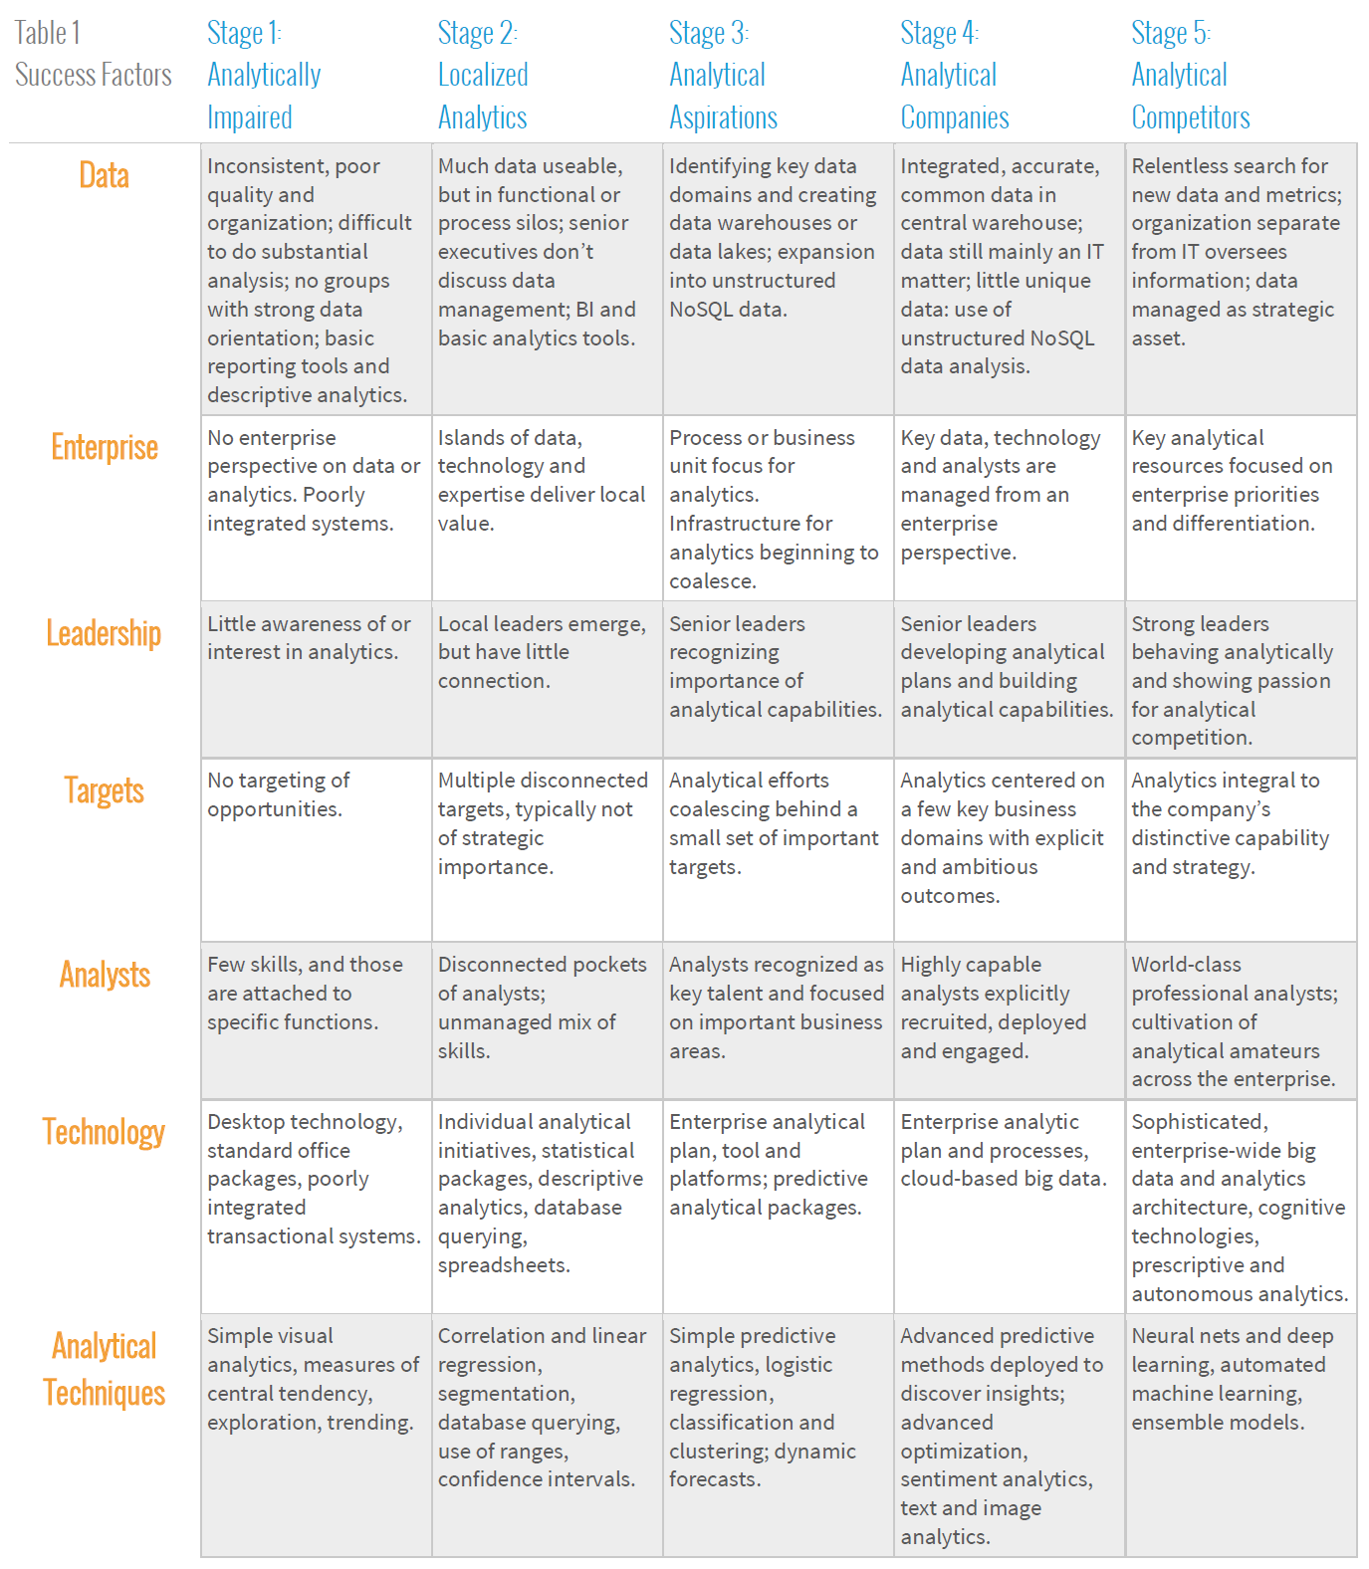
DELTA Rubric

Slide 6
D- DATA
Target manages petabytes of enterprise data through a centralized Analytical Platform Architecture.
Identified earlier issues: duplicate data, inconsistent pipelines, weak governance, and lack of visibility.
Built a data pipeline framework using Apache Spark and Scala, enabling certified, trusted datasets for all departments.
Introduced Atomic History → Core History → Aggregations → Analytical Datasets (ADS) model to ensure data lineage, quality, and traceability.
Certified Datasets guarantee reliability and are used for analytics, AI modeling, and business reporting across the enterprise.
Maintains 8 TB of data daily, with 1M+ queries and 4,000+ pipelines supported by Data Site Reliability Engineering (SRE) teams for monitoring and compliance.
Data governance strengthened through clear ownership, access control, and audit policies.
Result: consistent, reusable, scalable, and high-quality data driving Target’s data-driven culture.
Source: https://tech.target.com/blog/creating-certified-datasets

Slide 7
E- ENTERPRISE
Analytics embedded across all business areas from marketing and guest insights to supply chain, fulfillment, and store operations.
The Data Sciences team collaborates enterprise-wide, building certified datasets and predictive models accessible to all departments.
Developed enterprise-scale predictive modeling (e.g., Inventory-Not-Found (INF) model) to optimize product availability and fulfillment efficiency.
INF model runs ~250 million predictions per day, directly integrated into Target’s order-allocation systems to improve inventory accuracy and delivery performance.
Earlier initiatives like the Pregnancy Prediction Score unified marketing, loyalty, and sales data — demonstrating analytics alignment across functional silos.
Enterprise-level data platforms, shared governance, and cross-functional collaboration ensure analytics consistency and scalability.
Analytics outcomes directly influence operational, financial, and customer experience decisions organization-wide.
Result: analytics is a core enterprise capability, driving Target’s transformation into a data-driven, agile organization.
Source: Target Case Study (Forbes, 2012); https://tech.target.com/blog/predictive-modeling-for-availability

Slide 8
L- LEADERSHIP
Target’s analytics success is driven by executive commitment to a data-driven culture.
The Chief Data & Analytics Officer (CDAO) and senior leaders prioritize enterprise-wide adoption of analytics in decision-making.
Cross-functional data leadership teams (Data Science, SRE, Product Analytics) collaborate through the “Target Data Ecosystem.”
Leaders promote a “test and learn” mindset, supporting experimentation and rapid feedback loops.
Analytics maturity is measured and reported to leadership regularly, ensuring accountability and continuous investment.
Result: Leadership alignment enables sustained innovation and analytics integration across business units.

Slide 9
T - TARGETS
Target defines clear, measurable analytics goals aligned with strategic business outcomes.
Example initiatives: supply chain optimization, hyper-personalized marketing, real-time inventory visibility, and store operations forecasting.
Analytics teams use KPIs such as reduced stockouts, improved on-shelf availability, and increased digital conversion rates.
Quarterly “Analytics Targets Review” ensures data initiatives tie directly to ROI and customer satisfaction.
Result: Quantifiable targets guide analytics priorities, enabling business value realization and competitive advantage.

Slide 10
A- ANALYSTS
High investment in data science: hiring for senior roles, competitive pay and advancing adoption of analytical and generative AI.
Specialized Data Sciences teams build predictive models, optimize algorithms with machine learning, and validate solutions using advanced AI methods.
Analysts apply econometrics, optimization, and simulation to drive personalization (e.g., identifying pregnancy to personalize ads and coupons), fraud detection, automation, and inventory efficiency.
Embedded across business units (marketing, supply chain, fulfillment), ensuring insights directly support revenue growth and operational improvements.
Example: Supply Chain Data Science team determines optimal inventory quantities and placement across channels and locations, balancing cost efficiency with customer experience.
Notes:
Sr Data Scientist – Stores and Properties (applied ML, Simulation) Full-time Target job position: https://corporate.target.com/jobs/w48/70/sr-data-scientist-stores-and-properties-applied-ml%2C-simulation
Senior Data Scientist – Digital Fulfillment Full-time Target job position: https://corporate.target.com/jobs/w85/08/senior-data-scientist-%E2%80%93-digital-fulfillment-t
https://tech.target.com/teams/data-sciences

Slide 11
DELTA Rubric

Slide 12
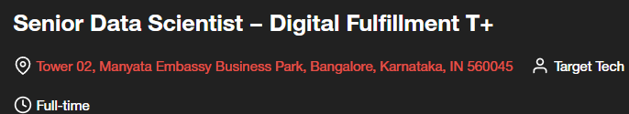
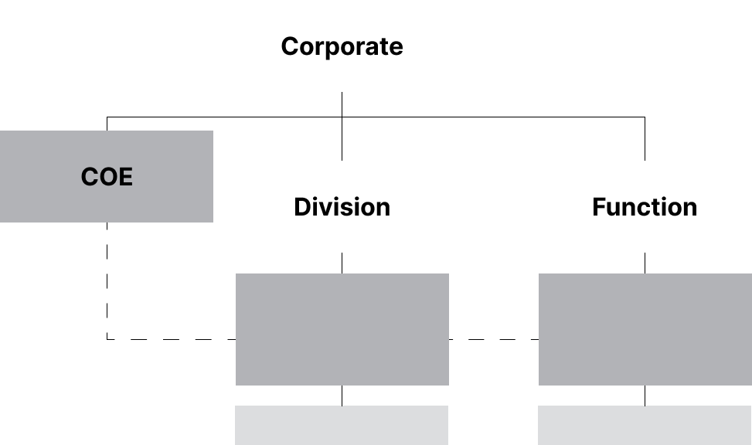
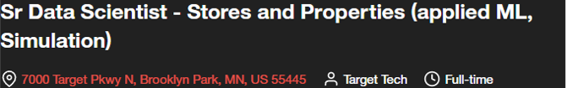
Center-of-Excellence (COE)
Analysts reside in major business units (marketing, supply chain, fulfillment), applying models and insights in their domains.
Notes:
Sr Data Scientist – Stores and Properties (applied ML, Simulation) Full-time Target job position: https://corporate.target.com/jobs/w48/70/sr-data-scientist-stores-and-properties-applied-ml%2C-simulation
Senior Data Scientist – Digital Fulfillment Full-time Target job position: https://corporate.target.com/jobs/w85/08/senior-data-scientist-%E2%80%93-digital-fulfillment-t
https://theorg.com/org/target/teams/data-analytics-and-engineering
https://tech.target.com/teams/data-sciences
Pg. 106 – figure 6-2
Pg. 107 of text book talks about COE

Slide 13
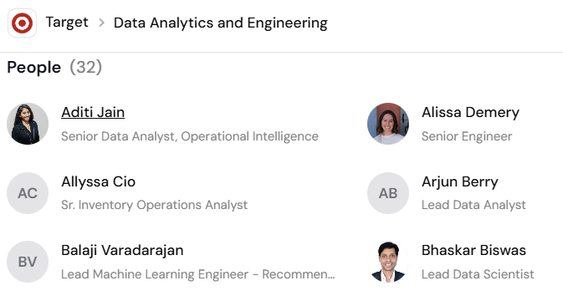
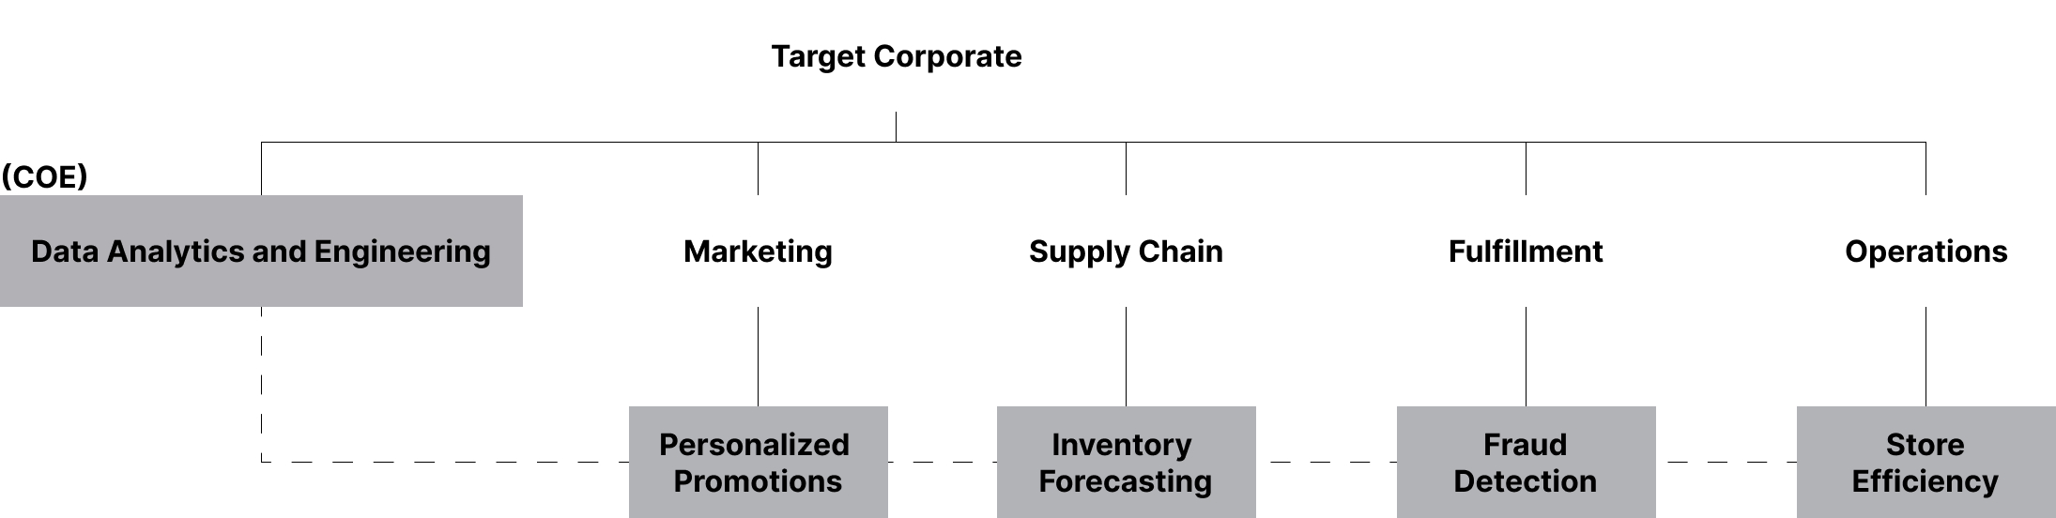
Center-of-Excellence (COE)
Analysts reside in major business units (marketing, supply chain, fulfillment), applying models and insights in their domains.
All analysts are members of the Data Science and Engineering team (COE).
Notes:
Sr Data Scientist – Stores and Properties (applied ML, Simulation) Full-time Target job position: https://corporate.target.com/jobs/w48/70/sr-data-scientist-stores-and-properties-applied-ml%2C-simulation
Senior Data Scientist – Digital Fulfillment Full-time Target job position: https://corporate.target.com/jobs/w85/08/senior-data-scientist-%E2%80%93-digital-fulfillment-t
https://theorg.com/org/target/teams/data-analytics-and-engineering
https://tech.target.com/teams/data-sciences

Slide 14
References
Davenport, T. H., Harris, J. G., & Morison, R. (2010). Analytics at work: Smarter decisions, better results. Harvard Business Review Press.
Hill, K. (2012, February 16). How Target figured out a teen girl was pregnant before her dad did. Forbes. https://www.forbes.com/sites/kashmirhill/2012/02/16/how-target-figured-out-a-teen-girl-was-pregnant-before-her-father-did/
Mitra, S., & Goel, A. (2024, July 24). Predictive modeling for availability of inventory. Target. https://tech.target.com/blog/predictive-modeling-for-availability
Orgio. (2025, September 3). Data analytics and engineering. https://theorg.com/org/target/teams/data-analytics-and-engineering
Target. (2025a, May 15). Data sciences. https://tech.target.com/teams/data-sciences
Target. (2025b, October 6). Senior data scientist – digital fulfillment T+. https://corporate.target.com/jobs/w85/08/senior-data-scientist-%E2%80%93-digital-fulfillment-t
Target. (2025c, October 2). Sr data scientist - stores and properties (applied ML, simulation). https://corporate.target.com/jobs/w48/70/sr-data-scientist-stores-and-properties-applied-ml%2C-simulation
Thompson, B., Ramamurthy, N., & Joshi, V. (2025, May 16). Creating certified datasets. https://tech.target.com/blog/creating-certified-datasets
Notes:
Analytics at Work: Smarter Decisions, Better Results
by Thomas H. Davenport (Author), Jeanne G. Harris (Author), Robert Morison (Author)

